Slide 1
2019;
PPTX;
MovieRec
CF Based Personalized Movie Recommendations

Slide 2
Ketika Pilihan
Terlalu Banyak
Pertumbuhan platform digital menyebabkan jumlah film yang tersedia semakin banyak, namun kondisi ini justru sering menimbulkan kesulitan bagi pengguna dalam menentukan pilihan yang sesuai dengan preferensi pribadi mereka.
NEW MOVIE
TEASER
MovieRec
Rio Ardana Putra

Slide 3
Tujuan Proyek
Arah dan Tujuan Pengembangan.
Projek ini dikembangkan sebagai sarana pembelajaran untuk memahami konsep sistem rekomendasi, mulai dari pengolahan data, pemilihan metode, hingga penanganan kasus khusus seperti keterbatasan data pengguna.
MovieRec
Rio Ardana Putra

Slide 4
Batasan agar Tetap Terfokus
Agar pengembangan tetap fokus dan sesuai dengan tujuan akademik, projek ini dibatasi pada aspek-aspek tertentu sehingga kompleksitas sistem tetap terkendali.
03
02
01
Input berupa
Dataset film dan rating dari
Angka User ID
Sistem rekomendasi menggunakan
MovieLens
User-Based CF
MovieRec
Rio Ardana Putra

Slide 5
Apa yang Dimaksud Sistem Rekomendasi
Sistem rekomendasi adalah sistem yang bertujuan menyarankan item yang relevan kepada pengguna berdasarkan data historis atau pola perilaku pengguna lain.
Personalisasi
Discovery
Option
Important subtitle text
development
MovieRec
Rio Ardana Putra

Slide 6

Pendekatan yang Tersedia
Content-Based Filtering
Collaborative Filtering
Sistem mempelajari item yang disukai pengguna di masa lalu, lalu merekomendasikan item serupa.
Rekomendasi dihasilkan berdasarkan kesamaan perilaku pengguna atau kesamaan item.
Hybrid Filtering
Knowledege-Based
Mengombinasikan CF, CBF, dan/atau KBRS untuk menutupi kelemahan masing-masing.
Rekomendasi dibuat menggunakan aturan, batasan, fungsi utilitas
MovieRec
Rio Ardana Putra

Slide 7

Mengapa Collaborative Filtering
Sebagai sistem rekomedasinya?.
Collaborative Filtering dipilih karena dapat memanfaatkan pola kolektif pengguna tanpa memerlukan fitur konten item, sehingga sesuai dengan dataset MovieLens yang berbasis rating.
01.
Berbasis rating user
02.
Tidak memerlukan konten film
MovieRec
Rio Ardana Putra

Slide 8
Pemilihan Pendekatan
Alasan Memilih
User-Based CF
User-Based Collaborative Filtering dipilih berdasarkan karakteristik dataset MovieLens dan keterbatasan sumber daya lokal, sehingga metode ini paling rasional untuk projek akademik berskala kecil.
Dataset berbasis user–rating
Relasi user mudah dianalisis
Tidak memerlukan training model
Dapat dijalankan di lingkungan lokal
MovieRec
Rio Ardana Putra

Slide 9
//-
Cara Kerja
UBCF
User-Based CF
<br>
UBCF bekerja dengan menganalisis kemiripan antar pengguna dan memanfaatkan preferensi pengguna yang mirip untuk menghasilkan rekomendasi.
coder://
MovieRec
2019.All Rights Reserved
Rio Ardana Putra

Slide 10
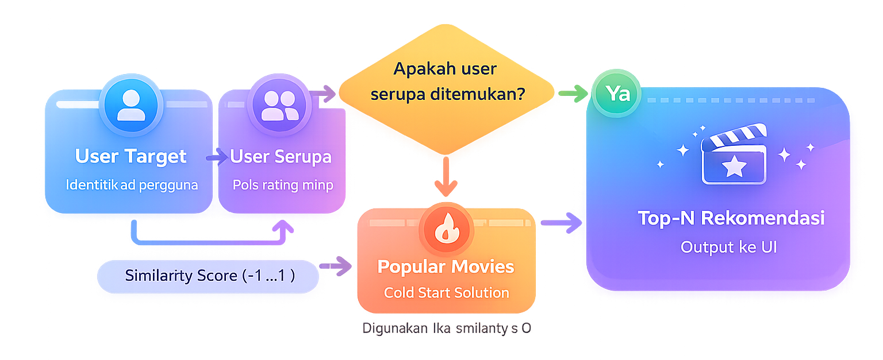
Alur Kerja Rekomendasi Sistem
Ringkasa proses dan Keputusan Sistem
MovieRec
Rio Ardana Putra

Slide 11
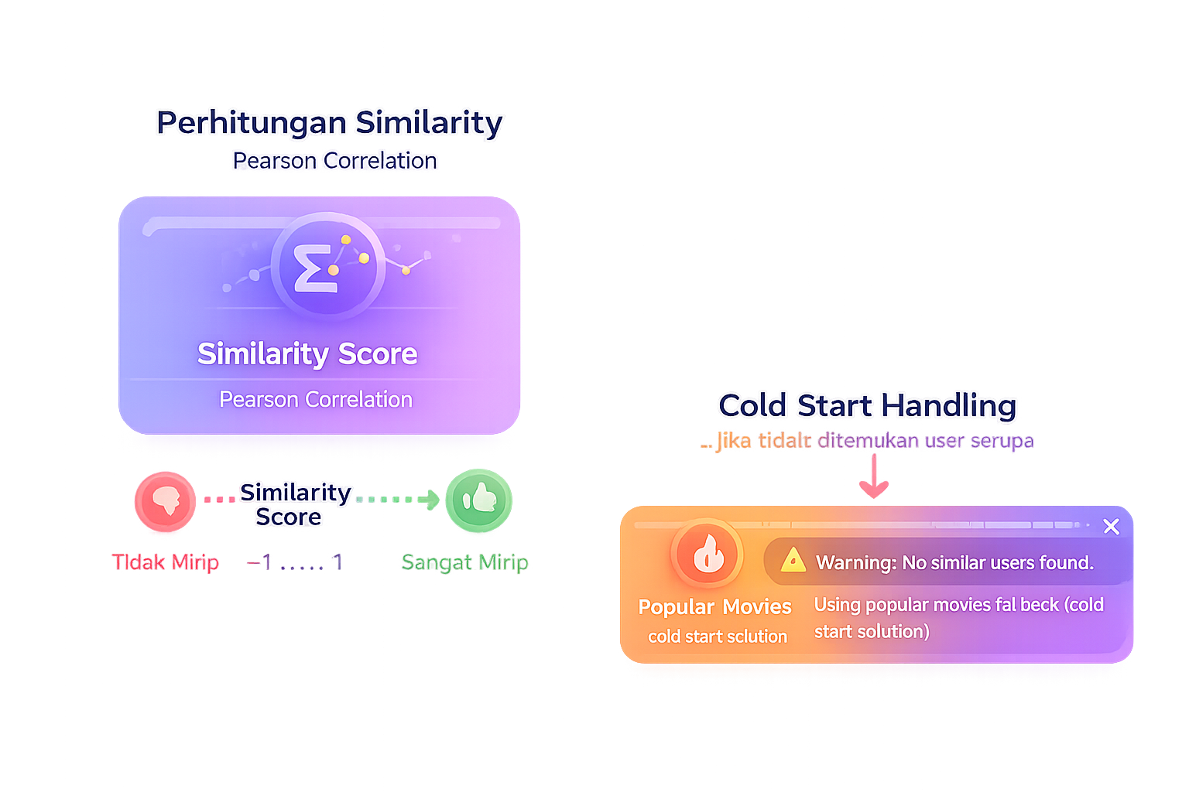
Mengukur Kemiripan
Secara Objektif
Kemiripan antar pengguna dihitung menggunakan Pearson Correlation untuk mengurangi bias perbedaan skala rating.
19
Nilai -1 hingga 1
21
Fokus pada pola, bukan nilai absolut
22
Metode standar dalam CF
MovieRec
Rio Ardana Putra

Slide 12

Menangani Kendala
Cold Start Pada Sistem
Cold Start Handling
Jika tidak ditemukan user serupa
1
Jika tidak ditemukan user serupa
2
Menggunakan popular movies fallback
3
Film populer dihitung berdasarkan rata-rata rating
MovieRec
Rio Ardana Putra

Slide 13
Keputusan Desain
Cold Start: Popular Movies Fallback
01.
Menghindari kegagalan sistem
03.
Menjaga pengalaman pengguna
Pendekatan popular movies digunakan sebagai solusi cold start karena bersifat netral, mudah dipahami, dan umum digunakan dalam sistem rekomendasi sebagai baseline.
02.
Tidak memerlukan data user
04.
Cocok untuk skala akademik
MovieRec
Rio Ardana Putra

Slide 14
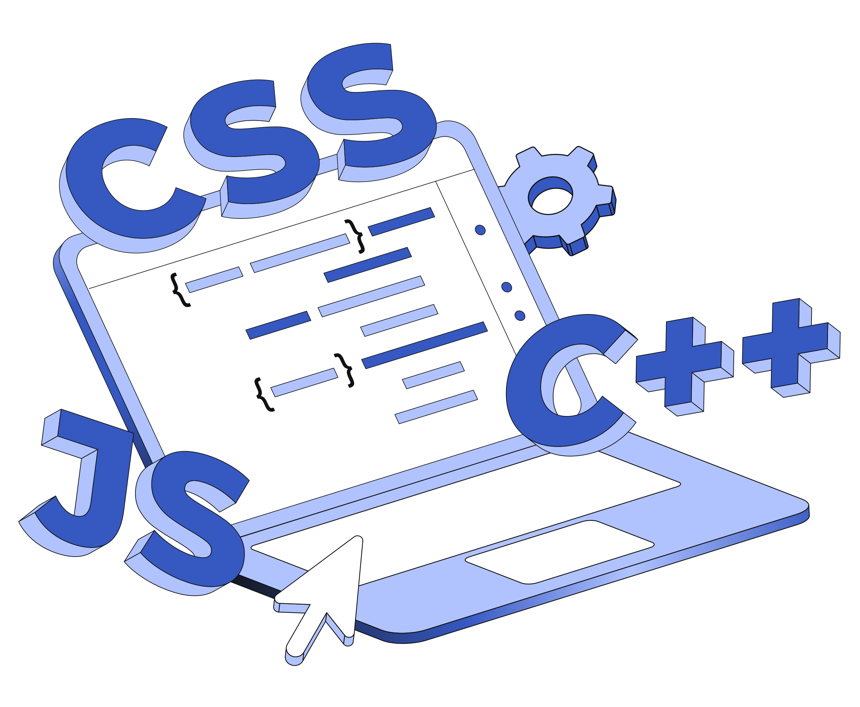
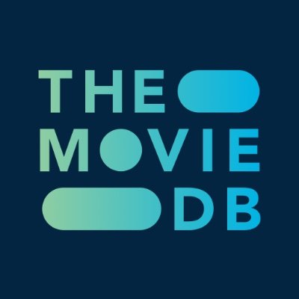


Backend
Menggunakan Bahasa yang kaya akan library dan function..
Arsitektur
Sistem
Frontend
Digunakan untuk menyajikan tampilan modern dan menarik.
MovieRec
Rio Ardana Putra

Slide 15
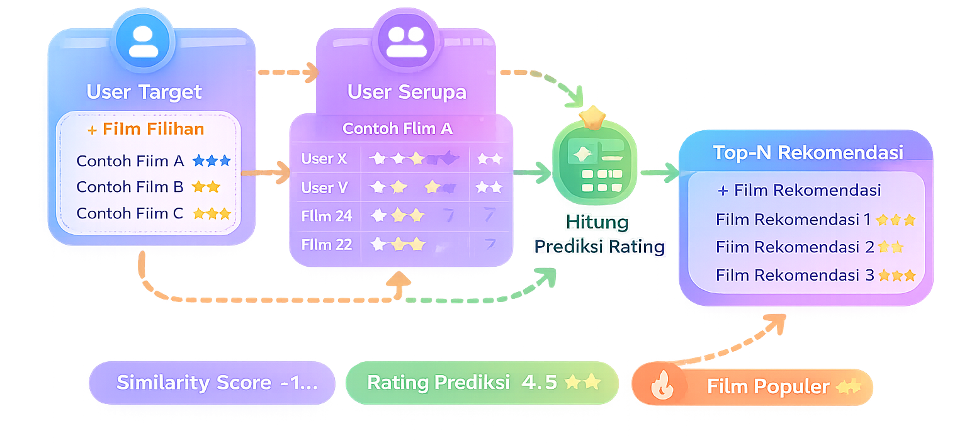
<15/>
Alur Kerja Sistem
Input User ID
Proses CF / fallback
Prediksi atau popular ranking
Tampilkan rekomendasi
MovieRec
Rio Ardana Putra

Slide 16
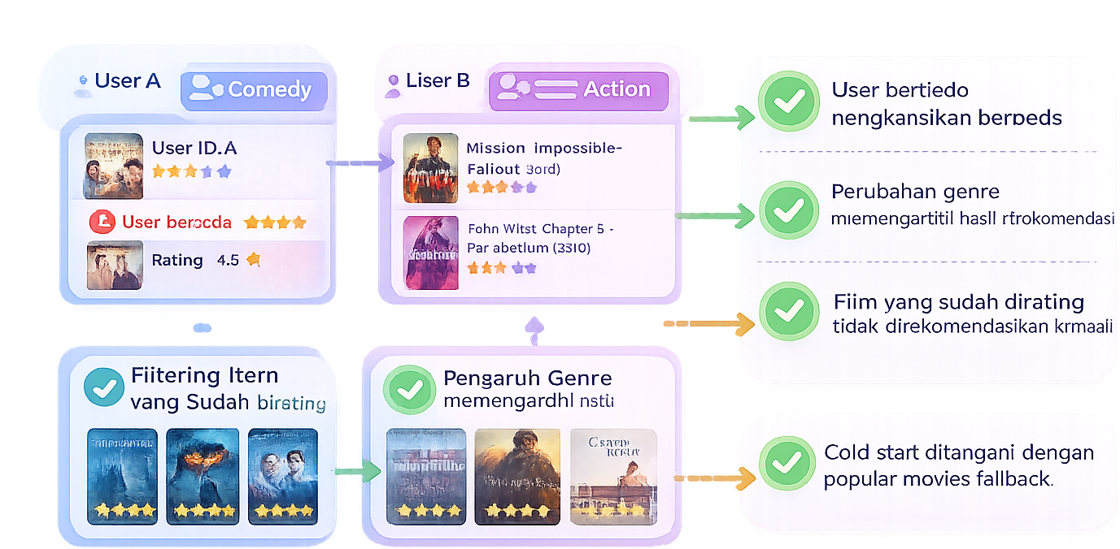
Notes:
Bukti Validasi:
User berbeda menghasilkan rekomendasi berbeda
Perubahan genre memengaruhi hasil rekomendasi
Film yang sudah dirating tidak direkomendasikan kembali
Cold start ditangani dengan popular movies fallback
Sistem tidak menghasilkan output kosong atau error

Slide 17
Analytics SWOT
Infographic Design With Modern Style
Notes:
Analisis SWOT digunakan untuk mengevaluasi sistem berdasarkan kondisi aktual implementasi, termasuk penanganan cold start.

Slide 18
Kekuatan sistem terletak pada kesesuaian metode dengan dataset serta desain sistem yang adaptif terhadap keterbatasan data pengguna.
SWOT
Strength
Adaptif terhadap cold start
Rangan & berjalan di sumber daya lokal
Arsitektur modular
Tidak memerlukan training model berat

Slide 19
SWOT
Keterbatasan Sistem
Weakness
Meskipun sistem telah dirancang agar stabil dan fungsional, masih terdapat beberapa keterbatasan yang menjadi konsekuensi dari pemilihan metode dan ruang lingkup akademik.
Notes:
Poin Weaknesses:
Akurasi rekomendasi bergantung pada ketersediaan rating user
Pada kondisi cold start, sistem menggunakan rekomendasi populer sehingga personalisasi berkurang
Kompleksitas meningkat jika jumlah user sangat besar (user–user similarity)
Belum dilakukan evaluasi performa numerik (RMSE, MAE, Precision)
Sistem masih menggunakan CSV, belum database terpusat

Slide 20
Peluang Pengembangan
SWOT
Pengembangan ke Hybrid Recommender
Opportunity
Personalisasi awal untuk mengurangi dampak cold start
Integrasi dengan database dan caching
<!--This is a comment. Comments are not displayed in the browser-->
Optimalisasi similarity menggunakan sparse matrix atau approximate methods

Slide 21
SWOT
Tantangan dan Risiko Sistem
Threat
Selain peluang, terdapat pula faktor eksternal dan teknis yang dapat memengaruhi kinerja dan keberlanjutan sistem jika dikembangkan lebih lanjut.
<!--This is a comment. Comments are not displayed in the browser-->
Notes:
Poin Threats:
Dataset yang semakin besar meningkatkan beban komputasi
Ketergantungan pada API eksternal (TMDB) untuk metadata dan poster
Popularity bias pada cold start fallback
Metode sederhana dapat kalah performa dibanding model ML lanjutan
Perubahan struktur dataset atau API dapat memerlukan penyesuaian sistem

Slide 22
2019;
PPTX;
coder://
programming powerpoint template

Slide 23

PPTX;
Validasi://
Notes:
Overview: Validasi hasil sistem dilakukan untuk memastikan bahwa rekomendasi yang dihasilkan bersifat konsisten, dapat dijelaskan secara logika, dan sesuai dengan konsep User-Based Collaborative Filtering, termasuk dalam kondisi keterbatasan data pengguna.

Slide 24
August 12, 2019
MORE DETAILS
你好
مرحبا
Hello
नमस्ते
World…
Ciao
We Are Coder://
안녕하세요.
Munich, Germany

Slide 25
Text Slide paragraph
text paragraph text
text paragraph text
text paragraph text
A Conference Planner
A Conference Planner
A Conference Planner
Important subtitle text
Important subtitle text
Important subtitle text
Important subtitle text
Important subtitle text
Important subtitle text
Important subtitle text
Important subtitle text
Important subtitle text
Important subtitle text
Important subtitle text
Important subtitle text

Slide 26
Code to the web design
There's no one "best" programming language, and once you've learned one, it's fairly easy to pick up another, so don't get hung too up on choosing your first language.
MORE DETAILS

Slide 27
basic to web development
Subtitle here
<!DOCTYPE html>
<html lang="en">
<head>
<title>Document</title>
</head>
<body>
<p>Hello World...</p>
<p>Start to learn HTML Code </p>
</body>
</html>
MORE DETAILS

Slide 28
<28/>
coder makes it easy and fun for you to code.
There's no one "best" programming language, and once you've learned one.
#include <stdio.h>
int main(void)
{
printf("hello, world\n");
}
Learn by
Doing://

Slide 29
Code Foundations
There's no one "best" programming language, and once you've learned one, it's fairly easy to pick up another.
MORE DETAILS

Slide 30


coder://
Ready to get started ?
There's no one "best" programming language, and once you've learned one, it's fairly easy to pick up another, so don't get hung too up on choosing your first language.
Learn more

Slide 31
Meet our team
Web Mentor
“A wonderful serenity has taken possession of my entire soul,
Szonja Odilo
Maïa Eliisa
Dubhghlas Tera
Job position
Job position
Job position
Mobile Mentor
“A wonderful serenity has taken possession of my entire soul,
Irene Marianne
Andrey Lore
Lucy Bharat
Job position
Job position
Job position

Slide 32
Eino Williric
There's no one "best" programming language, and once you've learned one, it's fairly easy to pick up another, so don't get hung too up on choosing your first language.
C# Language
85%
Golang Language
60%
Python Language
72%
Hello! world

Slide 33
“First, solve the problem.
Then, write the code”
John Johnson://

Slide 34
Gallery slide
There's no one "best" programming language, and once you've learned one, it's fairly easy to pick up another, so don't get hung too up on choosing your first language.
01
text paragraph text
Build your website
Play://
Coder://

Slide 35
Build web
Pages and site.
HTML5
CSS3
There's no one "best" programming language, and once you've learned one, it's fairly easy to pick up another, so don't get hung too up on choosing your first language.

Slide 36
Python
There's no one "best" programming language, and once you've learned one.
one "best" programming language
There's no one "best" programming language, and once you've learned one, it's fairly easy to pick up another, so don't get hung too up on choosing your first language.

Slide 38
Learn External CSS
Subtitle here
styles.css
External CSS
Example
body {
background-color: powderblue;
}
h1 {
color: blue;
}
p {
color: red;
}
An external style sheet is used to define the style for many HTML pages.
With an external style sheet, you can change the look of an entire web site, by changing one file!
To use an external style sheet, add a link to it in the <head> section of the HTML page:
<!DOCTYPE html>
<html>
<head>
<link rel="stylesheet“ href="styles.css">
</head>
<body>
<h1>This is a heading</h1>
<p>This is a paragraph.</p>
</body>
</html>
An external style sheet can be written in any text editor. The file must not contain any HTML code, and must be saved with a .css extension.
Here is how the "styles.css" looks:

Slide 39
coder makes it easy and fun for you to code.
Fully support language
JAVA
PHP
Python
There's no one "best" programming language, and once you've learned one, it's fairly easy to pick up another, so don't get hung too up on choosing your first language.
C++
C#
C
MORE DETAILS
More programming language

Slide 40
Example
JavaScript Date Reference
<p id="demo"></p>
<script>
var d = new Date();
document.getElementById("demo").innerHTML = d;
</script>
The Date object is used to work with dates and times. Date objects are created with new Date(). There are four ways of instantiating a date:
Result
Wed Apr 24 2019 14:15:03 GMT+0700 (Western Indonesia Time)
Date Object
var d = new Date();
var d = new Date(milliseconds);
var d = new Date(dateString);
var d = new Date(year, month, day, hours, minutes, seconds, milliseconds);

Slide 41


coder makes it easy and fun for you to code
There's no one "best" programming language, and once you've learned one, it's fairly easy to pick up another, so don't get hung too up on choosing your first language.
1
Choose what to learn
There's no one "best" programming language, and once you've learned one.
MORE DETAILS
coder://
2019.All Rights Reserved

Slide 42
<42/>
Learning by doing
There's no one "best" programming language, and once you've learned one.
2
Important subtitle text
Important subtitle text
Important subtitle text
Important subtitle text
coder://
2019.All Rights Reserved

Slide 43
Learning by doing
There's no one "best" programming language, and once you've learned one.
3
Important subtitle text
Important subtitle text
Important subtitle text
Important subtitle text
coder://
2019.All Rights Reserved

Slide 44
if(coffee=true) {
/* let’break with a cup coffe */
break;
}

Slide 45
TalkCode
Don't Learn to Code, Learn to Talk Code
Jerry Abraham

Slide 46
Slide Break

Slide 47
Example
<table>
<tr>
<th>Company</th> <th>Contact</th> <th>Country</th>
</tr>
<tr>
<td>Alfreds Futterkiste</td> <td>Maria Anders</td><td>Germany</td>
</tr>
<tr>
<td>Centro Moctezuma</td> <td>Francisco Chang</td> <td>Mexico</td>
</tr>
<tr>
<td>Ernst Handel</td> <td>Roland Mendel</td> <td>Austria</td>
</tr>
</table>
HTML Table Example
Result
Company | Contact | Country
Alfreds Futterkiste | Maria Anders | Germany
Centro Moctezuma | Francisco Chang | Mexico
Ernst Handel | Roland Mendel | Austria
MORE DETAILS

Slide 48


Go
Office Data Chart
C#
Important subtitle text
Programming
Important subtitle text
Language
Important subtitle text
Python
C++
Important subtitle text

Slide 49
Development
Development
There's no one "best" programming language, and once you've learned one.
There's no one "best" programming language, and once you've learned one.
MORE DETAILS
MORE DETAILS

Slide 50
<50/>
Office Data Chart
140
120
100
80
Important subtitle text
60
Important subtitle text
40
20
Important subtitle text
Jan
Feb
Mar
Apr
May
Jun
Jul
Aug
Sep
Oct
Important subtitle text

Slide 51
coder makes it easy and fun for you to code
There's no one "best" programming language, and once you've learned one, it's fairly easy to pick up another, so don't get hung too up on choosing your first language.
65%
45%
85%
Option one
Option two
Option three
Next
Next
Next

Slide 52
Process strategy to be master code
01
02
03
Learn by doing
Try Something new
Development
There's no one "best" programming language, and once you've learned one.
There's no one "best" programming language, and once you've learned one.
There's no one "best" programming language, and once you've learned one.

Slide 53
Premium
Pricing Plan
Basic
Pro
$85,99
$47,99
$65,99
There's no one "best" programming language, and once you've learned one, it's fairly easy to pick up another, so don't get hung too up on choosing your first language.
Insert Text in This Text
Insert Text in This Text
Insert Text in This Text
Insert Text in This Text
Insert Text in This Text
Insert Text in This Text
MORE DETAILS
PURCHASE
PURCHASE
PURCHASE

Slide 54

Social Media
Coder://
10k
100k
Followers
2M
Subscribe

Slide 55
Mind map infographic slide
C++
C#
There's no one "best" programming language, and once you've learned one.
06
There's no one "best" programming language, and once you've learned one.
Programming
Language
Python
Java
There's no one "best" programming language, and once you've learned one.
05
There's no one "best" programming language, and once you've learned one.
Php
There's no one "best" programming language, and once you've learned one.

Slide 56
mini puzzle game
Subtitle here
public class MyClass {
public static void main(String[] args) {
for (int i = 0; i < 5; i++) {
System.out.println(i) ;
} }
}
Result Code
1
2
3
4
5
for
(i)
i++

Slide 57
Binary tree
0
1
2
3
4
5
6
7
8
9
10
11
12
13
14
1000 <-> 2000
0
1000 <-> 1500
1500 <-> 2000
1
2
1000 <-> 1250
1250 <-> 1500
1500 <-> 1750
1750 <-> 2000
3
4
5
6
1000 <-> 1125
1125 <-> 1250
1250 <-> 1375
1375 <-> 1500
1500 <-> 1625
1625 <-> 1750
1750 <-> 1875
1875 <-> 2000
7
8
9
10
11
12
13
14

Slide 58
Learn Matrix
1
3
4
1
3
4
Matrix 1
2
4
3
Matrix 2
2
5
3
3
4
5
3
7
2
1+1
3+3
4+4
There's no one "best" programming language, and once you've learned one, it's fairly easy to pick up another, so don't get hung too up on choosing your first language.
Matrix x
2+2
4+5
3+3
3+3
4+7
5+2

Slide 59

Id card event
mockup
There's no one "best" programming language, and once you've learned one, it's fairly easy to pick up another, so don't get hung too up on choosing your first language.
MORE DETAILS

Slide 60
Mockup slide
http://www.website.com

Slide 61
<61/>
01
text paragraph text
Smartphone
mockup
A Coding Planner
C#
Go
Important subtitle text
Important subtitle text
Python
Important subtitle text
Important subtitle text
C++

Slide 62
75%
United Kingdom
Subtitle Here
50%
There's no one "best" programming language, and once you've learned one, it's fairly easy to pick up another.
Subtitle Here
MORE DETAILS
65%
Option one
Subtitle Here

Slide 63
Australia Map
Important subtitle text
85%
Important subtitle text
Important subtitle text
Important subtitle text
Option three
Next

Slide 64
World Map slide
Option one
There's no one "best" programming language, and once you've learned one, it's fairly easy to pick up another.
MORE DETAILS
<!--This is a comment. Comments are not displayed in the browser-->

Slide 65
Address
There's no one "best" programming language, and once you've learned one.
Our
Phone number
There's no one "best" programming language, and once you've learned one.
Office
Websites
@coder_officials
There's no one "best" programming language, and once you've learned one.

Slide 66
Thank you
For your attention

